Slide 1

Health Hub
Health Hub to order/search for Health clubs, doctors, medical services, hospitals, health insurance
By
Chandu Chinta A20450371
Vaishnavi Manjunath A20446043

Slide 2

Project Description & Specification
A health portal to search doctors for online consultation/appointment, find hospitals, buy health Insurance plans, join health clubs and order medicines(pharmacy).
User Type:
User:
Register, Login and establish user profile
View and Search for doctors/hospitals etc.,
Schedule/Cancel/Reschedule an appointment
Deliver/pick-up medicine
Lab test reports – email/pickup
Trending services, events
Write provider reviews

Slide 3
Project Description & Specification
Provider:
Register and Login and establish provider profile
Update/Delete profile
Provide services like offers, events etc.,
Admin:
Review provider applications
Manage provider/user accounts
Maintain customer review statistics

Slide 4
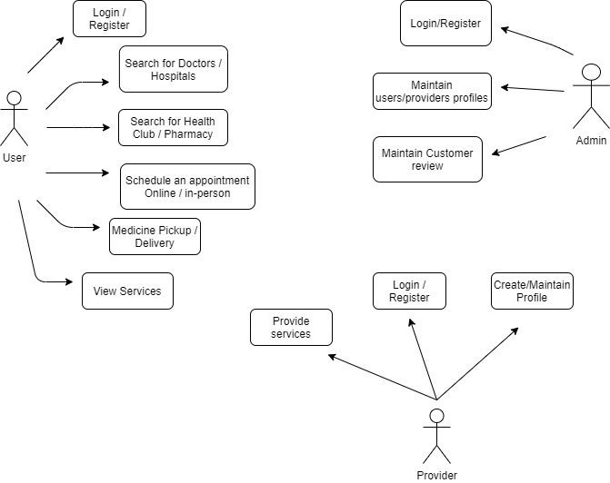
Use Case Diagram

Slide 5
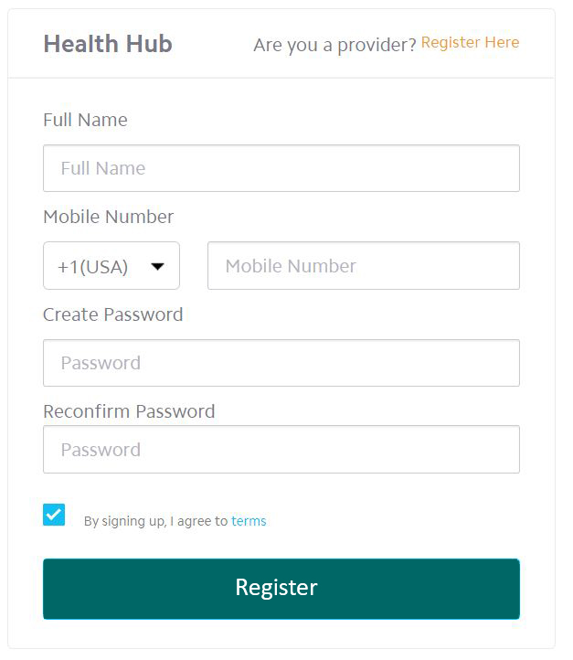
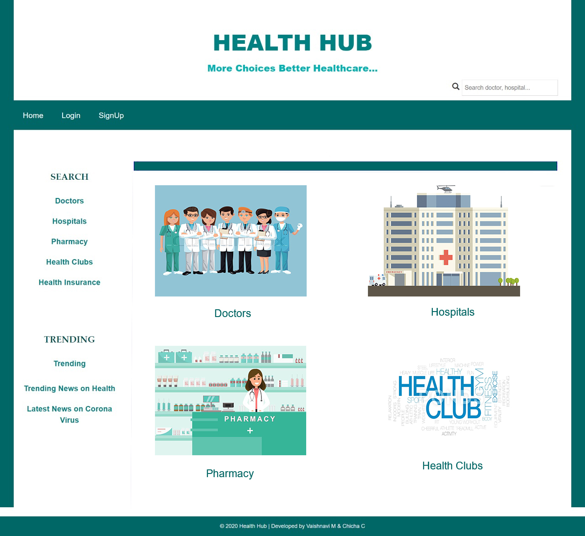
Main Web page of the application (prototype)

Slide 6
Technologies
HTML
CSS
Bootstrap
Java
JavaScript
JSP
Servlet
MySQL
MongoDB

Slide 7
Thank You
Questions?
Stay safe!

